Slide 1

Database systems using MongoDB
Lab 2

Slide 2
The insert Method
To insert data into MongoDB collection, you need to use MongoDB's Insert or save method.
Syntax
>db.COLLECTION_NAME.insert(document)
Example:
db.mycol.insert({
_id: ObjectId(7df78ad8902c),
title: 'MongoDB Overview',
description: 'MongoDB is no sql database',
tags: ['m ongodb', 'database', 'NoSQL'],
likes: 100
})

Slide 3
The insert Method
Here mycol is our collection name.
If the collection doesn't exist in the database, then MongoDB will create this collection and then insert document into it.
If we don't specify the _id parameter, then MongoDB assigns an unique ObjectId for this document.
To insert multiple documents in single query, pass an array of documents in insert command.

Slide 4
Example
>db.post.insert([
{
title: 'MongoDB Overview',
description: 'MongoDB is no sql database',
tags: ['mongodb', 'database', 'NoSQL'],
likes: 100
},
{
title: 'NoSQL Database',
description: 'NoSQL database doesn't have tables',
tags: ['mongodb', 'database', 'NoSQL'],
likes: 20,
comments: [
{
user:’user1’, message: 'My first comment',
dateCreated: new Date(2013,11,10,2,35), like: 0
}]
}
])

Slide 5
The find Method
To query data from MongoDB collection, you need to use MongoDB's find method.
Syntax
>db.COLLECTION_NAME.find()
find method will display all the documents in a non structured way.
The pretty Method
To display the results in a formatted way, you can use pretty method.
Syntax:
>db.mycol.find().pretty()

Slide 6
Example
>db.mycol.find().pretty()
{
"_id": ObjectId(7df78ad8902c),
"title": "MongoDB Overview",
"description": "MongoDB is no sql database",
"tags": ["m ongodb", "database", "NoSQL"],
"likes": "100"
}

Slide 7
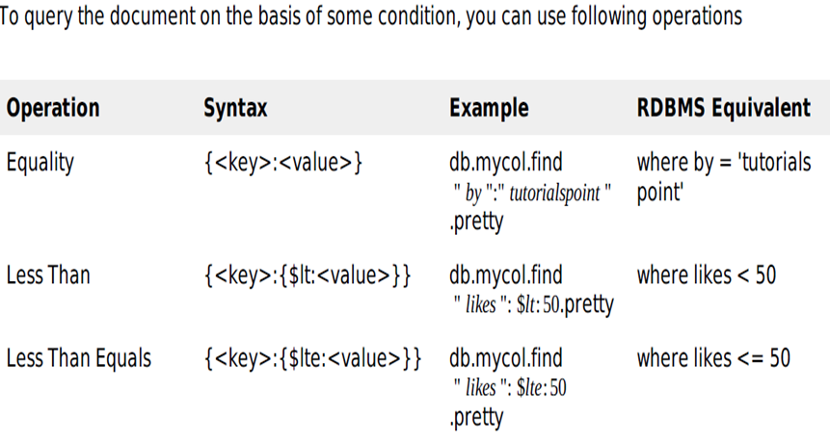
RDBMS Where Clause Equivalents in MongoDB

Slide 8

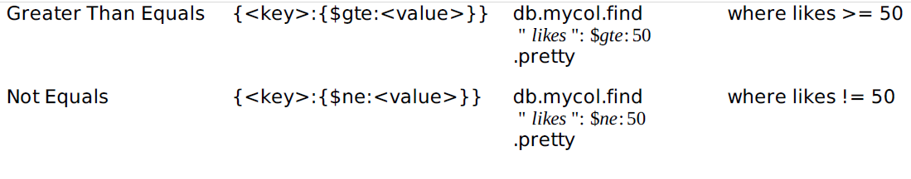
RDBMS Where Clause Equivalents in MongoDB

Slide 9
Example
> db.s.find({usn:{$gt:3}}).pretty()
{
"_id" : ObjectId("59a38d9044336d19e526548f"),
"usn" : 4,
"name" : "sdf",
"sem" : 3,
"dept" : "eee",
"gender" : "f"
}

Slide 10
AND in MongoDB
Syntax:
In the find method if you pass multiple keys by separating them by ',' then MongoDB treats it AND condition.
>db.m ycol.find({key1:value1, key2:value2}).pretty()
Example
Following example will show all the tutorials written by 'tutorials point' and whose title is
'MongoDB Overview'

Slide 11
Checking 2 conditions with and without using AND
Without AND
>db.s.find({dept:'cse',gender:'f'}).pretty()
With AND
> db.s.find({$and:[{dept:'cse'},{gender:'f'}]}).pretty()
{
"_id" : ObjectId("59a38d1d44336d19e526548c"),
"usn" : 1,
"name" : "abc",
"sem" : 3,
"dept" : "cse",
"gender" : "f"
}

Slide 12
OR in MongoDB
Syntax:
To query documents based on the OR condition, you need to use $or keyword. Basic syntax of OR
is shown below:
>db.m ycol.find(
{
$or: [
{key1: value1}, {key2:value2}
]
}
).pretty()

Slide 13
Example
Below given example will show all the tutorials whose title is 'MongoDB Overview‘ or likes=100
>db.m ycol.find({$ or:[{"title": "MongoDB Overview"},{likes:100}]}).pretty()
{
"_id": ObjectId(7df78ad8902c),
"title": "MongoDB Overview",
"description": "MongoDB is no sql database",
"tags": ["m ongodb", "database", "NoSQL"],
"likes": "100"
}

Slide 14
MongoDB Update method
The update method updates values in the existing document.
Syntax:
>db.COLLECTION_NAME.update(SELECTION_CRITERIA, UPDATED_DATA)
Example
Consider the mycol collection has following data.
{ "_id" : ObjectId(5983548781331adf45ec5), "title":"MongoDB Overview"}
{ "_id" : ObjectId(5983548781331adf45ec6), "title":"NoSQL Overview"}
{ "_id" : ObjectId(5983548781331adf45ec7), "title":"Tutorials Point Overview"}

Slide 15
MongoDB Update method
Following example will set the new title 'New MongoDB Tutorial' of the documents whose title is 'MongoDB Overview'
>db.m ycol.update({'title':'MongoDB Overview'},{$ set:{'title':'New MongoDB Tutorial'}})
>db.mycol.find()
{ "_id" : ObjectId(5983548781331adf45ec5), "title":"New MongoDB Tutorial"}
{ "_id" : ObjectId(5983548781331adf45ec6), "title":"NoSQL Overview"}
{ "_id" : ObjectId(5983548781331adf45ec7), "title":"Tutorials Point Overview"}

Slide 16
MongoDB Update method
By default mongodb will update only single document, to update multiple you need to set a
parameter 'multi' to true.
>db.m ycol.update({'title':'MongoDB Overview'},{$set:{'title':'New MongoDB
Tutorial'}},{multi:true})

Slide 17
The remove Method
MongoDB's remove method is used to remove document from the collection.
remove method accepts two parameters. One is deletion criteria and second is justOne flag
1. deletion criteria : Optional deletion criteria according to documents will be removed.
2. justOne : Optional if set to true or 1, then remove only one document.
Syntax:
>db.COLLECTION_NAME.remove(DELETION_CRITERIA)

Slide 18
Example
Consider the mycol collectioin has following data.
{ "_id" : ObjectId(5983548781331adf45ec5), "title":"MongoDB Overview"}
{ "_id" : ObjectId(5983548781331adf45ec6), "title":"NoSQL Overview"}
{ "_id" : ObjectId(5983548781331adf45ec7), "title":"Tutorials Point Overview"}
Following example will remove all the documents whose title is 'MongoDB Overview'
>db.m ycol.remove({'title':'MongoDB Overview'})
>db.m ycol.find()
{ "_id" : ObjectId(5983548781331adf45ec6), "title":"NoSQL Overview"}
{ "_id" : ObjectId(5983548781331adf45ec7), "title":"Tutorials Point Overview“}

Slide 19
The remove Method
Remove only one
If there are multiple records and you want to delete only first record, then set justOne parameter in remove method
>db.COLLECTION_NAME.remove(DELETION_CRITERIA,1)
Remove All documents
If you don't specify deletion criteria, then mongodb will delete whole documents from the collection. This is equivalent of SQL's truncate command.
>db.mycol.remove()
>db.mycol.find()

Slide 20
MONGODB PROJECTION
Projection - select only necessary data rather than selecting whole of the data of a document.
If a document has 5 fields and you need to show only 3, then select only 3 fields from them.
The find Method
MongoDB's find method accepts second optional parameter that is list of fields that you want to retrieve.
In MongoDB when you execute find method, then it displays all fields of a document.
To limit this you need to set list of fields with value 1 or 0. 1 is used to show the field while 0 is used to hide the field.

Slide 21
MONGODB PROJECTION
Syntax:
>db.COLLECTION_NAME.find({},{KEY:1})
Example
Consider the collection myycol has the following data
{ "_id" : ObjectId(5983548781331adf45ec5), "title":"MongoDB Overview"}
{ "_id" : ObjectId(5983548781331adf45ec6), "title":"NoSQL Overview"}
{ "_id" : ObjectId(5983548781331adf45ec7), "title":"Tutorials Point Overview"}
Following example will display the title of the document while querying the document.
>db.mycol.find({},{"title":1,_id:0})
{"title":"MongoDB Overview"}
{"title":"NoSQL Overview"}
{"title":"Tutorials Point Overview"}

Slide 22
Read only the names of students in dept CSE
db.s.find({dept:'cse'},{name:1}).pretty()
{ "_id" : ObjectId("59a38d1d44336d19e526548c"), "name" : "abc" }
{ "_id" : ObjectId("59a38d3044336d19e526548d"), "name" : "def" }
Read the student documents in dept CSE without the name field
db.s.find({dept:'cse'},{name:0}).pretty()
{
"_id" : ObjectId("59a38d1d44336d19e526548c"),
"usn" : 1,
"sem" : 3,
"dept" : "cse",
"gender" : "f"
}

Slide 23
The Limit Method
To limit the records in MongoDB, you need to use limit method.
limit method accepts one number type argument, which is number of documents that you want to displayed.
Syntax:
>db.COLLECTION_NAME.find().limit(NUMBER)
If you don't specify number argument in limit method then it will display all documents from the collection.

Slide 24
Example
Consider the collection mycol has the following data
{ "_id" : ObjectId(5983548781331adf45ec5), "title":"MongoDB Overview"}
{ "_id" : ObjectId(5983548781331adf45ec6), "title":"NoSQL Overview"}
{ "_id" : ObjectId(5983548781331adf45ec7), "title":"Tutorials Point Overview"}
Following example will display only 2 documents while quering the document.
>db.mycol.find({},{"title":1,_id:0}).limit(2)
{"title":"MongoDB Overview"}
{"title":"NoSQL Overview"}

Slide 25
MongoDB Skip Method
Skip method also accepts number type argument and used to skip number of documents.
Syntax:
>db.COLLECTION_NAME.find().limit(NUMBER).skip(NUMBER)
Example:
Following example will only display only second document.
>db.m ycol.find({},{"title":1,_id:0}).limit(1).skip(1)
{"title":"NoSQL Overview"}
>
Note: default value in skip method is 0

Slide 26
The sort Method
sort method accepts a document containing list of fields along with their sorting order.
To specify sorting order :
1 for ascending order
-1 is used for descending order
Syntax
>db.COLLECTION_NAME.find().sort({KEY:1})

Slide 27
Example for sorting
Following example will display the documents sorted by title in descending order.
>db.m ycol.find({},{"title":1,_id:0}).sort({"title":-1})
{"title":"Tutorials Point Overview"}
{"title":"NoSQL Overview"}
{"title":"MongoDB Overview"}
Note: If you don't specify the sorting preference, then sort method will display documents in
ascending order.

Slide 28
Example
db.s.find().sort({usn:-1})
// Sort based on the descending order of USN
{ "_id" : ObjectId("59a38d9044336d19e526548f"), "usn" : 4, "name" : "sdf", "sem" : 3, "dept" : "eee", "gender" : "f" }
{ "_id" : ObjectId("59a38d4744336d19e526548e"), "usn" : 3, "name" : "xyz", "sem" : 3, "dept" : "ece", "gender" : "m" }
{ "_id" : ObjectId("59a38d3044336d19e526548d"), "usn" : 2, "name" : "def", "sem" : 3, "dept" : "cse", "gender" : "m" }

Slide 29
Aggregation functions (group by) in MongoDB
$sum
$avg
$min
$max
$count
$first
$last

Slide 30
$sum operator - sum of salary by group in MongoDB $sum operator returns the sum of all numeric values of documents in the collection in MongoDB
Find sum of salary of all employee with same firstName in collection in MongoDB >
We will group employee by firstName and find sum of salary of each group.
We will use aggregate() method, $sum operator and $group operator
db.employee.aggregate([{$group : {_id : "$firstName", salary_sum : {$sum : "$salary"}}}])
Output:
{ "_id" : "ank", "salary_sum" : 3000 }
{ "_id" : "sag", "salary_sum" : 7000 }
{ "_id" : "neh", "salary_sum" : 5000 }
Sql query equivalent to above MongoDB query is >
select firstName, sum(salary) salary_sum from employee group by firstName;

Slide 31
Find sum of salary of all employee in collection in MongoDB
We will group employee by null (nothing) and find sum of salary of group (there will be only 1 group - i.e. whole documents of collection)
We will use aggregate() method, $group operator, and _id : null
db.employee.aggregate([{$group : {_id : null, salary_sum : {$sum : "$salary"}}}])
Output
{ "_id" : null, "salary_sum" : 15000 }
Sql query equivalent to above MongoDB query is >
select sum(salary) salary_sum from employee;

Slide 32
How to write aggregate query with where clause in MongoDB
Find sum of salary of all employee with same firstName where salary > 2000 in collection in MongoDB
We will find document where salary > 2000
We will use $match operator
Then we will group employee by firstName and find sum of salary of each group.
We will use aggregate() method, $group operator
db.employee.aggregate([
{ $match: { salary : { $gt: 2000} } },
{$group : {_id : "$firstName", salary_sum : {$sum : "$salary"}}}])
Output >
{ "_id" : "sag", "salary_sum" : 7000 }
{ "_id" : "neh", "salary_sum" : 5000 }
Sql query equivalent to above MongoDB query is >
select firstName, sum(salary) salary_sum from employee
where salary > 2000 group by firstName

Slide 33
Count() / $count
Find count of all employee where salary >= 2000 in collection in MongoDB
We will use find() and count() methods.
db.employee.find( { salary : {$gte : 2000} } ).count()
Output >
4
Sql query equivalent to above MongoDB query is >
select count(*) from employee where salary >= 2000

Slide 34
Use of $count() operator to find count of all employee where salary >= 2000 in collection in MongoDB.
Note : $count can be used in MongoDB 3.4 or above.
db.employee.aggregate( [ { $match: { salary : { $gte: 2000 } } }, { $count: "firstName" } ] )
Output >
4

Slide 35
$avg Find average of salary of all employee with same firstName in collection in MongoDB
We will group employee by firstName and find average of salary of each group.
We will use aggregate() method, $avg operator and $group operator.
db.employee.aggregate([{$group : {_id : "$firstName", salary_average : {$avg : "$salary"}}}])
Output >
{ "_id" : "ank", "salary_average" : 1500 }
{ "_id" : "sag", "salary_average" : 3500 }
{ "_id" : "neh", "salary_average" : 5000 }
Sql query equivalent to above MongoDB query is >
select firstName, avg(salary) salary_average from employee group by firstName;

Slide 36
$min and $max
Find minimum salary of employee with same firstName in collection in MongoDB
db.employee.aggregate([{$group : {_id : "$firstName", salary_minimum : {$min : "$salary"}}}])
Output >
{ "_id" : "ank", "salary_minimum" : 1000 }
{ "_id" : "sag", "salary_minimum" : 3000 }
Find maximum salary of all employee in collection in MongoDB
db.employee.aggregate([{$group : {_id : null, salary_maximum : {$max : "$salary"}}}])
Output >
{ "_id" : null, "salary_maximum" : 5000 }

Slide 37
$first and $last
$first operator returns the first document from documents in the collection in MongoDB.
Find first salary of all employee in collection in MongoDB
db.employee.aggregate([{$group : {_id : null, salary_first : {$first : "$salary"}}}])
Output >
{ "_id" : null, "salary_first" : 1000 }
$last operator returns the last document from documents in the collection in MongoDB.
Find last salary of all employee in collection in MongoDB
db.employee.aggregate([{$group : {_id : null, salary_last : {$last : "$salary"}}}])
Output >
{ "_id" : null, "salary_last" : 5000 }

Slide 38
Using like statement (as in sql) in MongoDB
find document in mongoDB is similar to like '%b%' in sql
db.testCollection.find({name : /b/})
{ "_id" : ObjectId("585008261127dea5ece72759"), "name" : "abc" }
{ "_id" : ObjectId("585008261127dea5ece7275a"), "name" : "bcd" }
find document in mongoDB is similar to like 'b%' in sql
> db.testCollection.find({name : /^b/})
{ "_id" : ObjectId("585008261127dea5ece7275a"), "name" : "bcd" }
find document in mongoDB is similar to like '%f' in sql
> db.testCollection.find({name : /f$/})
{ "_id" : ObjectId("585008261127dea5ece7275b"), "name" : "def" }

Slide 39
Why Sharding?
Sharding is the process of storing data records across multiple machines and it is MongoDB's approach to meeting the demands of data growth.
As the size of the data increases, a single machine may not be sufficient to store the data nor provide an acceptable read and write throughput.
Sharding solves the problem with horizontal scaling.
Horizontal Scaling involves dividing the system dataset and load over multiple servers, adding additional servers to increase capacity as required.
With sharding, you add more machines to support data growth and the demands of read and write operations.

Slide 40
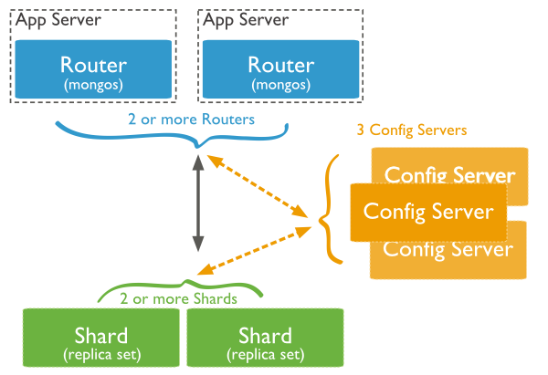
Sharding in MongoDB using sharded cluster
Shards − Shards are used to store data. They provide high availability and data consistency.
Config Servers − Config servers store the cluster's metadata. This data contains a mapping of the cluster's data set to the shards. The query router uses this metadata to target operations to specific shards.
Query Routers − Query routers are basically mongo instances, interface with client applications and direct operations to the appropriate shard. The query router processes and targets the operations to shards and then returns results to the clients. A sharded cluster can contain more than one query router to divide the client request load. A client sends requests to one query router.

Slide 41
Thank you

